Slide 1
Introduction to Computing
Lecture 2: Number Systems

Slide 2
Number Systems
Notes:
Các hệ số

Slide 3
Objective
After studying this chapter, the student should be able to:
Understand the concept of number systems
Distinguish between nonpositional and positional number systems
Describe the decimal, binary, hexadecimal, octal system
System conversion

Slide 4
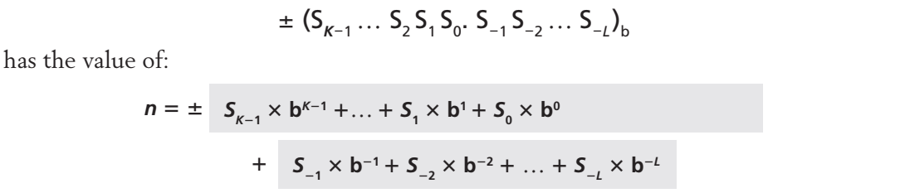
Introduction
Number system
Define how a number can be represented using distinct symbols
A number can be represented differently in different systems
Positional Number Systems
In a positional number system, the position a symbol occupies in the number determines the value it represents
Notes:
Hệ đếm theo vị trí của ký số (Positional number system)

Slide 5
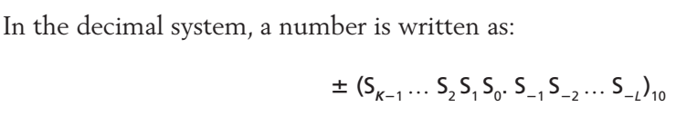
The decimal system (base 10)
The set of symbols is S = {0, 1, 2, 3, 4, 5, 6, 7, 8, 9}

Slide 6
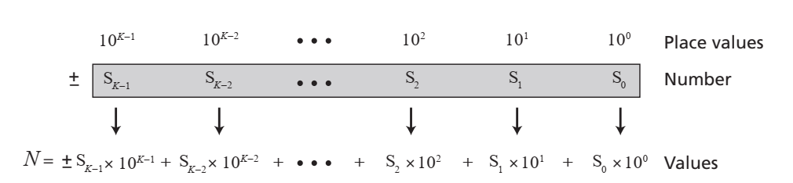
Integers
An integer: an integral number with no fractional (phần thập phân) part
Notes:
Số nguyên
Không có phần thập phân

Slide 7
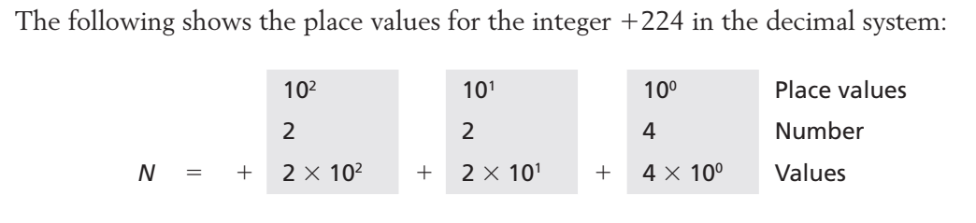
Example 1

Slide 8
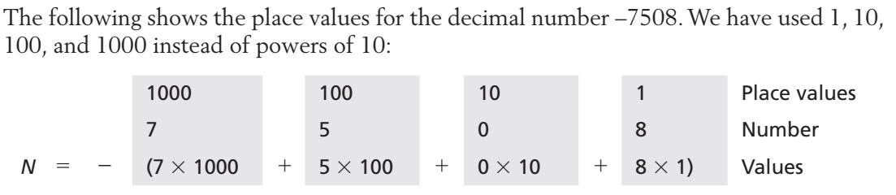
Example 2

Slide 9
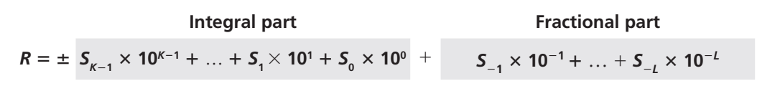
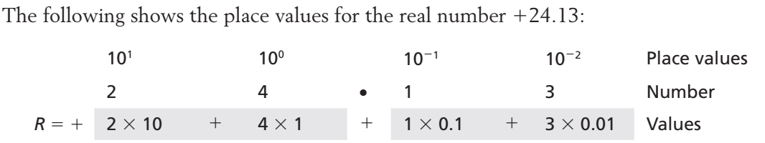
Real Number
A real: a number with a fractional part

Slide 10
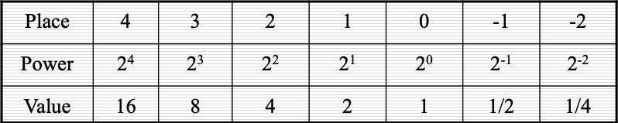
The binary system (base 2)
Binary numbers are used in today’s digital computers
Using two symbols, S = {0, 1}.
The symbols in this system are often referred to as binary digits or bits (binary digit).
Base is 2 -> each place value is a power of 2

Slide 11
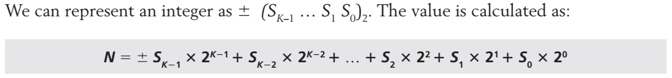
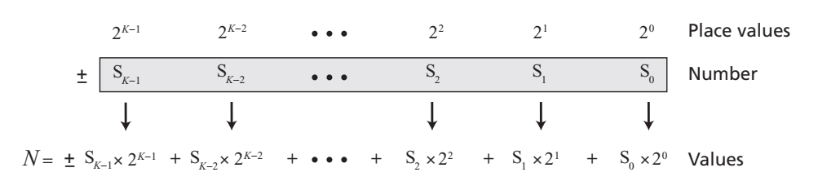
Integers

Slide 12
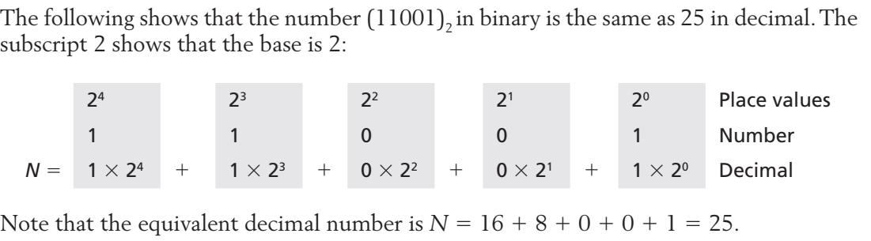
Example

Slide 13
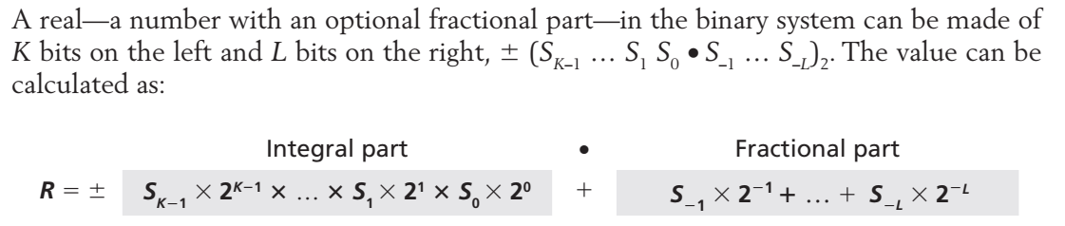
Real
Notes:
Mechanical machines (Cơ)

Slide 14
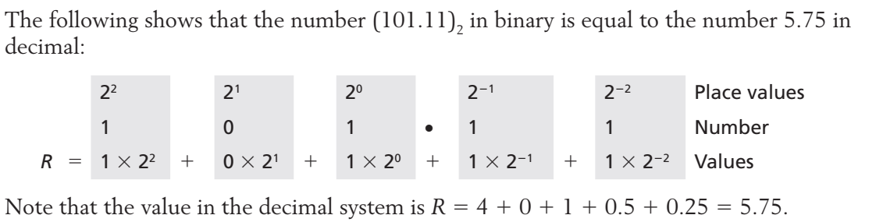
Example

Slide 15
The octal & hexadecimal system
Binary numbers are used by digital computers but very confusing, especially large numbers
Decimal numbers are used naturally by human beings but are not readily (một cách dễ dàng) converted to or from binary numbers
Octal and Hexadecimal numbers are used in preference to decimal numbers, as they are easily converted to and from binary numbers

Slide 16
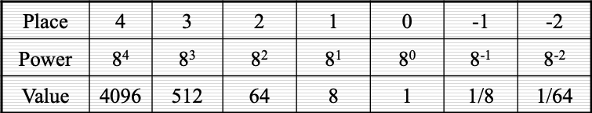
The octal system (base 8)
The base b = 8 using eight symbols S = {0, 1, 2, 3, 4, 5, 6, 7} to represent a number.
The symbols in this system are often referred to as octal digits.
Each place value has the power of eight
Notes:
Von Neuman: Von Neuman architecture:
Computers built on the von Neumann model divide the computer hardware into four subsystems: memory, arithmetic logic unit, control unit, and input/output.
Memory
Output data
Memory is the storage area. This is where programs and data are stored during processing. We discuss the reasons for storing programs and data later in the chapter.
Arithmetic logic unit
The arithmetic logic unit (ALU) is where calculation and logical operations take place. For a computer to act as a data processor, it must be able to do arithmetic operations on data (such as adding a list of numbers). It should also be able to do logical operations on data, as we will see in Chapter 4.
Control unit
The control unit controls the operations of the memory, ALU, and the input/output subsystem.
Input / output
The input subsystem accepts input data and the program from outside the computer, while the output subsystem sends the result of processing to the outside world. The definition of the input/output subsystem is very broad: it also includes secondary storage devices such as disk or tape that stores data and programs for processing. When a disk stores data that results from processing, it is considered an output device: when it reads data from the disk, it is considered an input device.

Slide 17
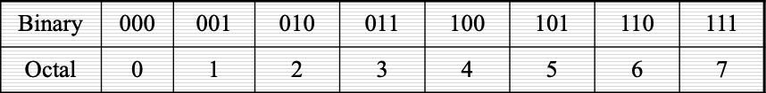
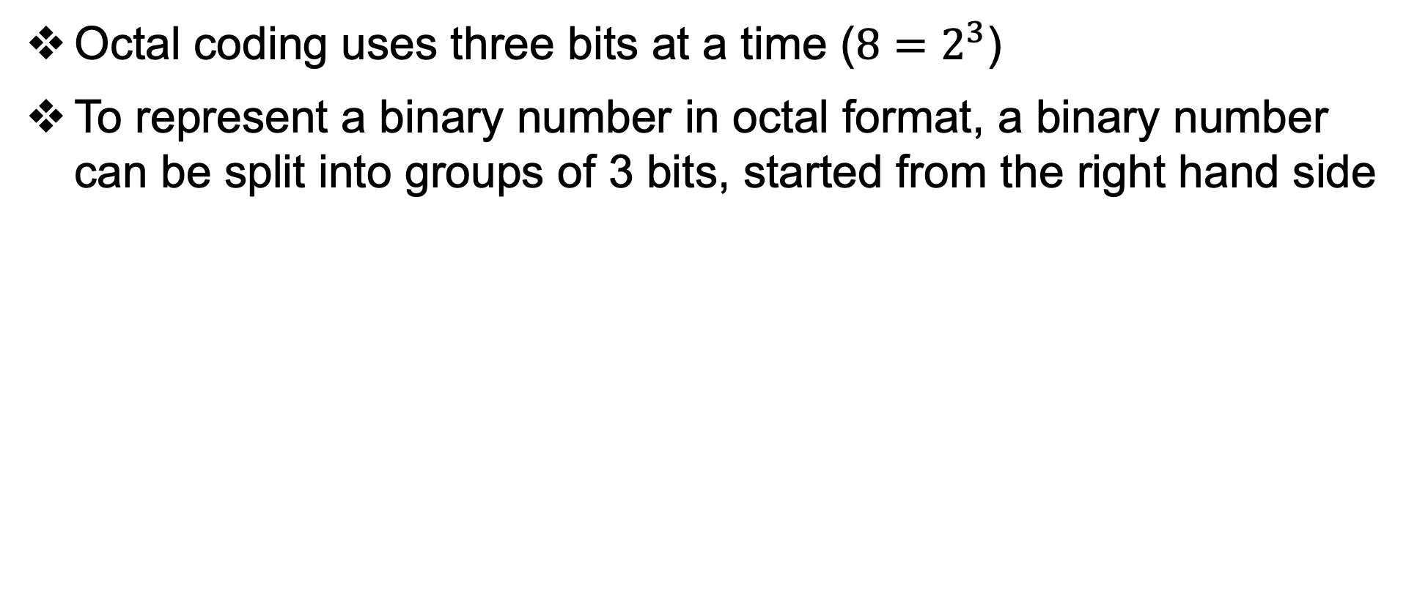
The octal system (base 8)
Octal coding uses three bits at a time ($8=2^{3}$)
To represent a binary number in octal format, a binary number can be split into groups of 3 bits, started from the right hand side
Notes:
Von Neuman: Von Neuman architecture:
Computers built on the von Neumann model divide the computer hardware into four subsystems: memory, arithmetic logic unit, control unit, and input/output.
Memory
Output data
Memory is the storage area. This is where programs and data are stored during processing. We discuss the reasons for storing programs and data later in the chapter.
Arithmetic logic unit
The arithmetic logic unit (ALU) is where calculation and logical operations take place. For a computer to act as a data processor, it must be able to do arithmetic operations on data (such as adding a list of numbers). It should also be able to do logical operations on data, as we will see in Chapter 4.
Control unit
The control unit controls the operations of the memory, ALU, and the input/output subsystem.
Input / output
The input subsystem accepts input data and the program from outside the computer, while the output subsystem sends the result of processing to the outside world. The definition of the input/output subsystem is very broad: it also includes secondary storage devices such as disk or tape that stores data and programs for processing. When a disk stores data that results from processing, it is considered an output device: when it reads data from the disk, it is considered an input device.

Slide 18
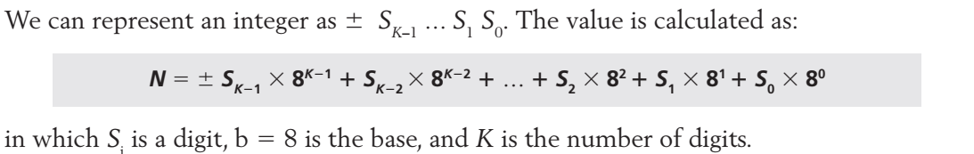
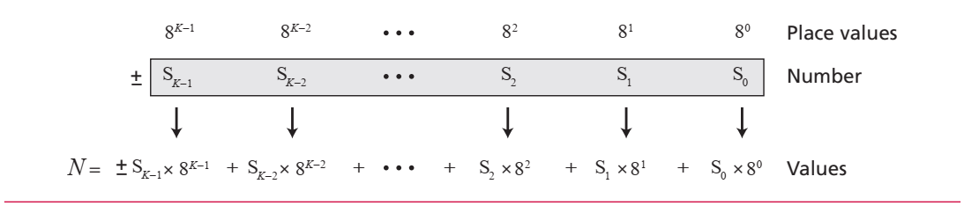
Integers
Notes:
https://vi.wikipedia.org/wiki/L%E1%BB%8Bch_s%E1%BB%AD_ph%E1%BA%A7n_c%E1%BB%A9ng_m%C3%A1y_t%C3%Adnh
Z3
- Hoàn thành vào năm 1941 tại Đức
- Máy tính số điều khiển kỹ thuật số đầu tiên trên thế giới
Colossus
- Xây dựng vào năm 1943 tại Vương quốc Anh
- Thiết bị tính toán hoàn toàn điện tử đầu tiên

Slide 19
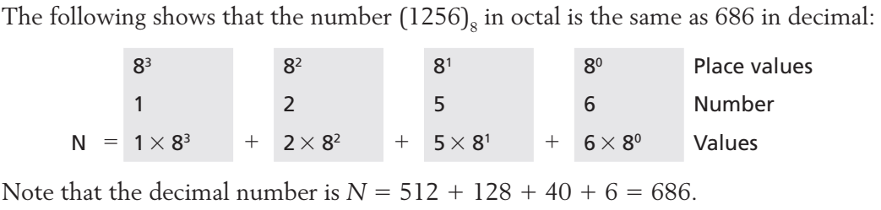
Example
Notes:
Máy tính tưng tự (Máy tính cơ)

Slide 20
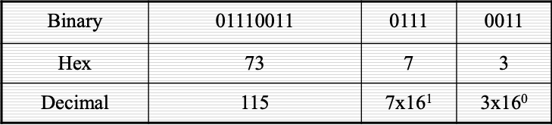
The hexadecimal system (base 16)
The base b =16 using 16 symbols to represent a number.
The set of symbols is S = {0, 1, 2, 3, 4, 5, 6, 7, 8, 9, A, B, C, D, E, F}.
A, B, C, D, E, F (uppercase or lowercase) are equivalent to 10, 11, 12, 13, 14, and 15 respectively.
To represent a hexadecimal symbol, a group of 4 bits is needed
In practice, hexadecimal is used in preference to octal as computer memory is organized into groups of 8 bits, which is a multiple of 4

Slide 21
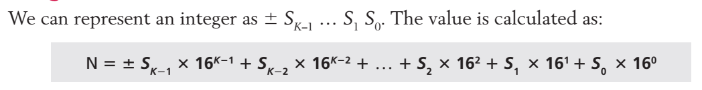
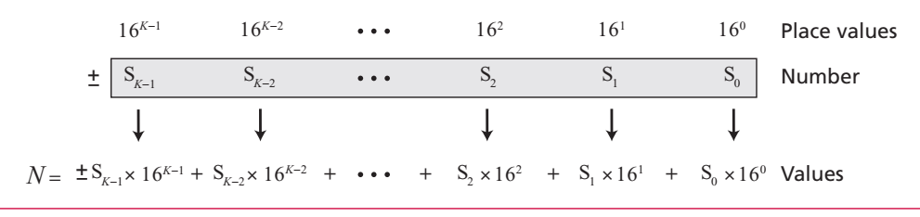
Integers

Slide 22
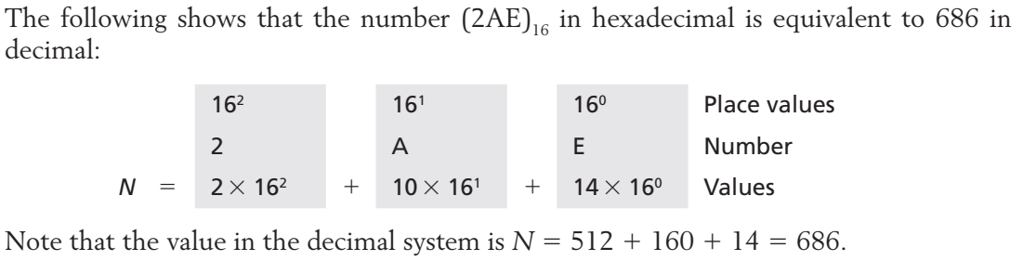
Example
Notes:
https://vi.wikipedia.org/wiki/L%E1%BB%8Bch_s%E1%BB%AD_ph%E1%BA%A7n_c%E1%BB%A9ng_m%C3%A1y_t%C3%ADnh

Slide 23
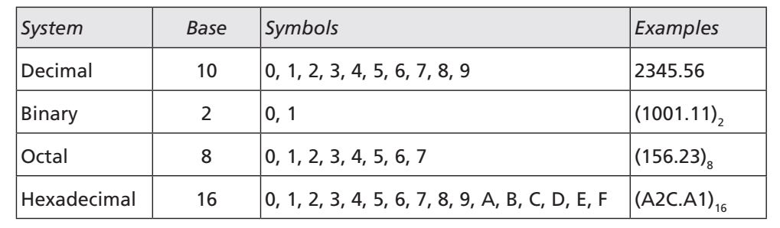
Summary of the four positional systems

Slide 24
Number Base Conversions
Notes:
Các hệ số

Slide 25
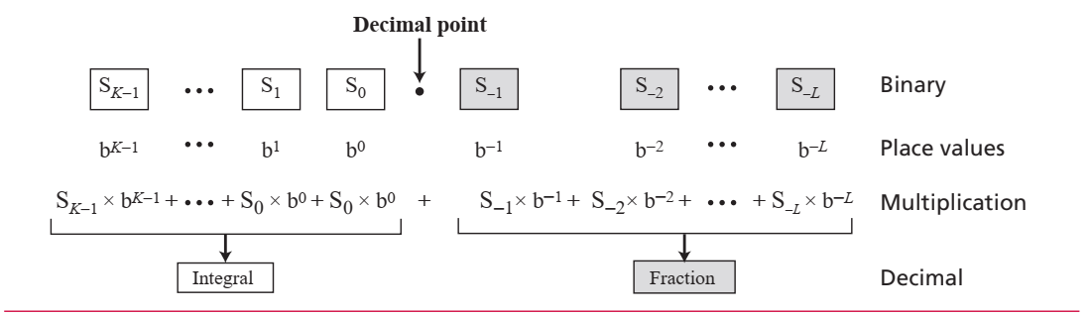
Any base to decimal conversion
We multiply (nhân) each digit with its place value in the source system and add the results to get the number in the decimal system.

Slide 26
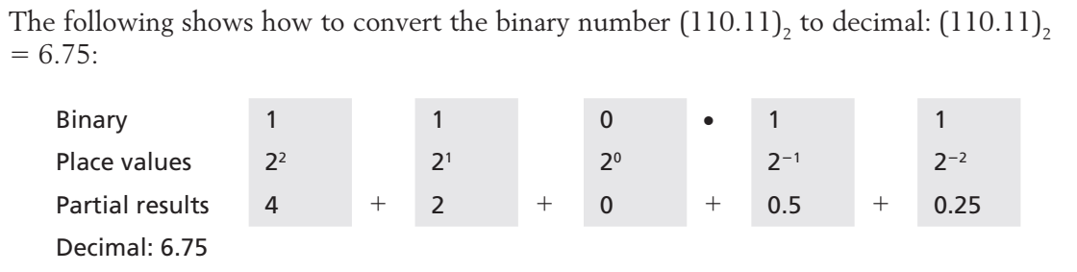
Example 1

Slide 27
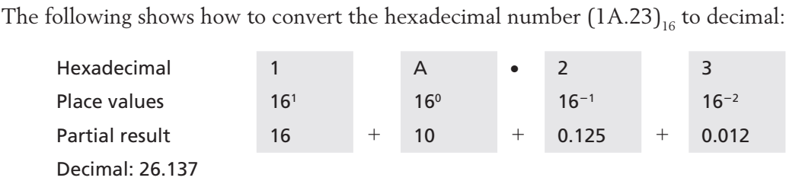
Example 2

Slide 28
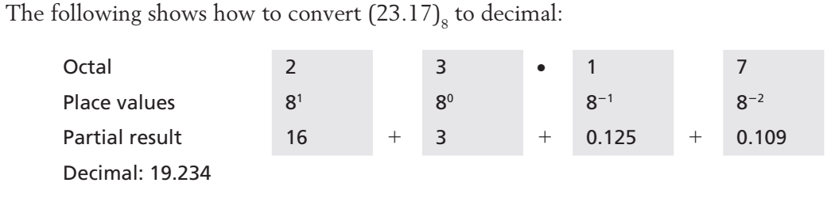
Example 3

Slide 29
Decimal to any base
We can convert a decimal number to its equivalent (tương đương) in any base.
Two procedures: one for the integral part and one for the fractional part
Converting integral part: using repetitive (lặp lại) division (phép chia).
Converting the fractional part: using repetitive multiplication (phép nhân)

Slide 30
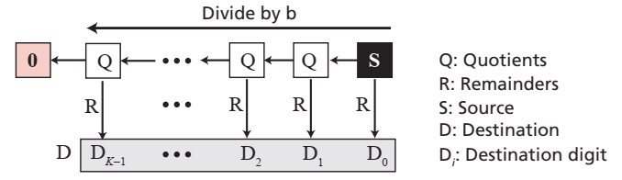
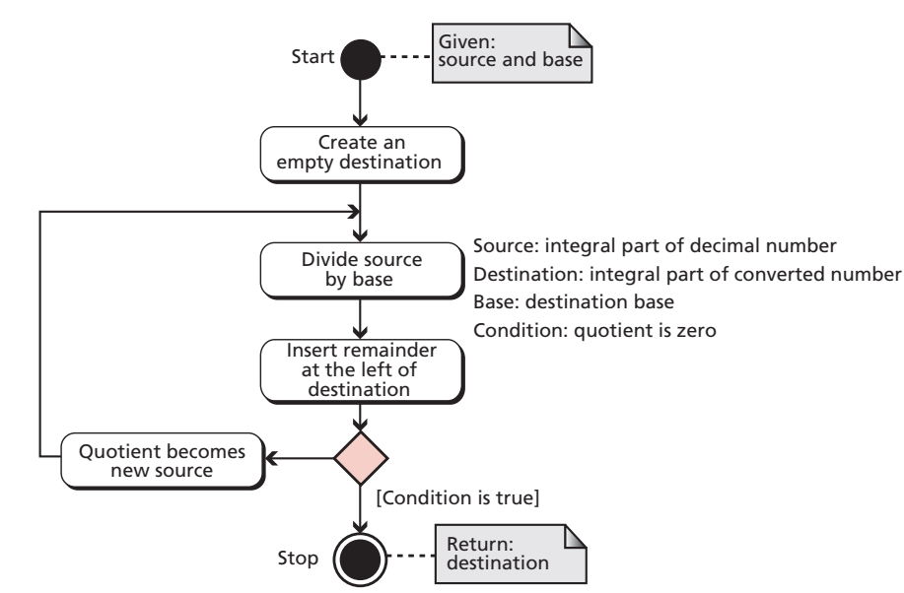
Algorithm to convert the integral part

Slide 31
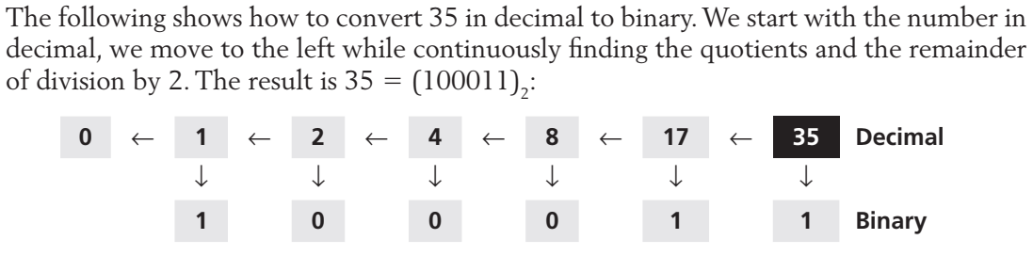
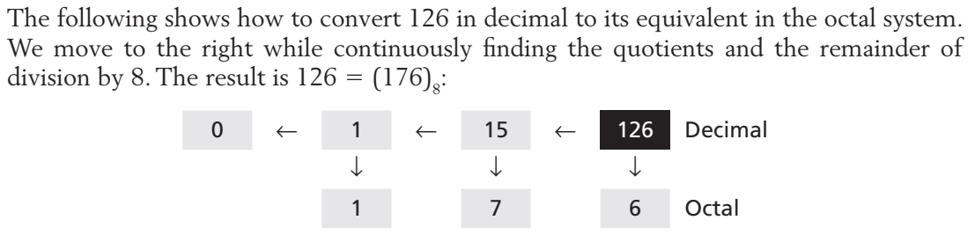
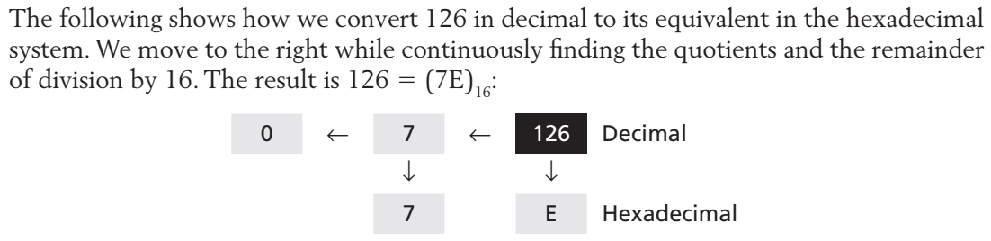

Slide 32
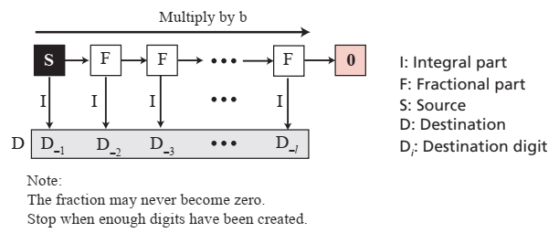
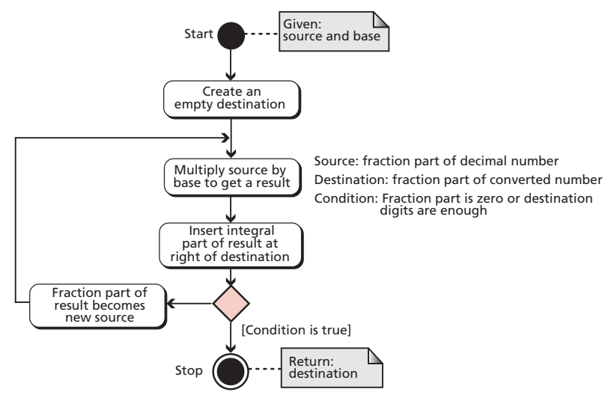
Converting the fractional part

Slide 33
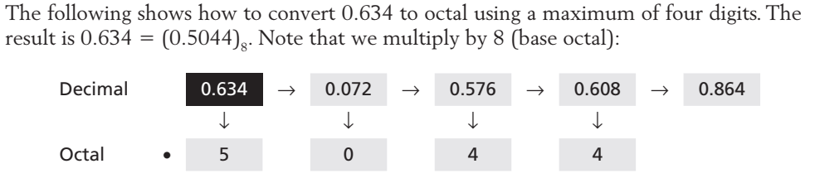
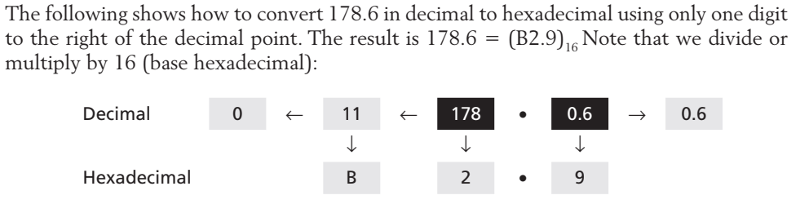
Example

Slide 34
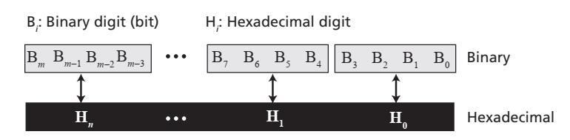
Binary–hexadecimal conversion

Slide 35
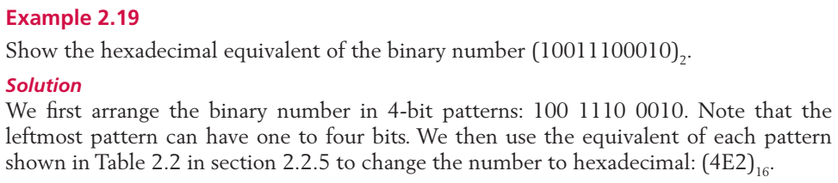
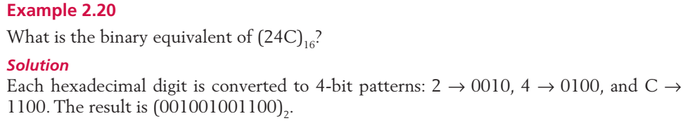
Example

Slide 36
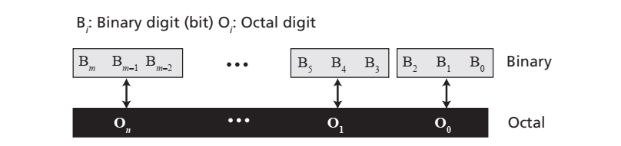
Binary–octal conversion

Slide 37
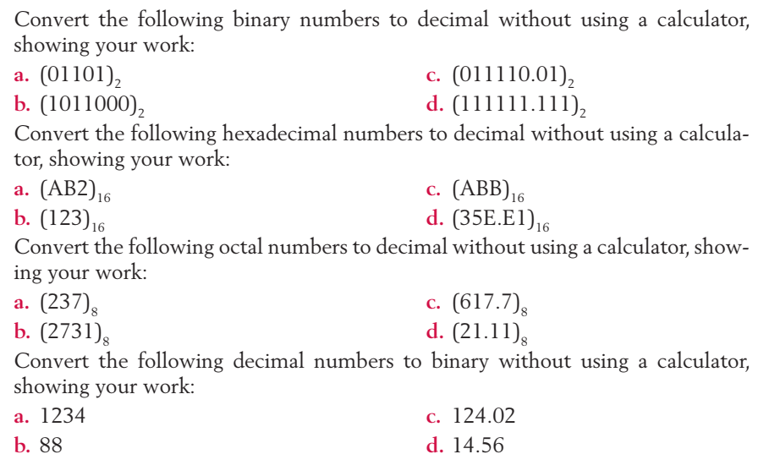
Exercises

Slide 38
Q & A

